Slide 1
The Airy Process and Dyson Brownian Motion
Aviva Englander

Slide 2
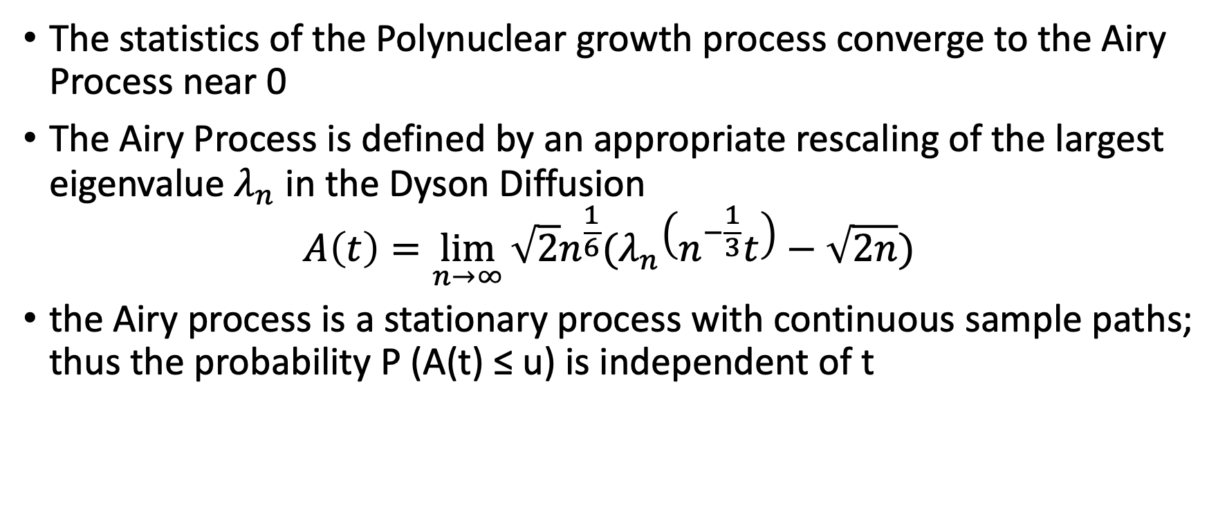
Definition of the Airy Process
The statistics of the Polynuclear growth process converge to the Airy Process near 0
The Airy Process is defined by an appropriate rescaling of the largest eigenvalue $λ_{n}$ in the Dyson Diffusion
$$A\left(t\right)=\lim_{n→∞}{\sqrt{2}n^{\frac{1}{6}}(λ_{n}\left(n^{−\frac{1}{3}}t\right)−\sqrt{2n})}$$
the Airy process is a stationary process with continuous sample paths; thus the probability P (A(t) ≤ u) is independent of t

Slide 3
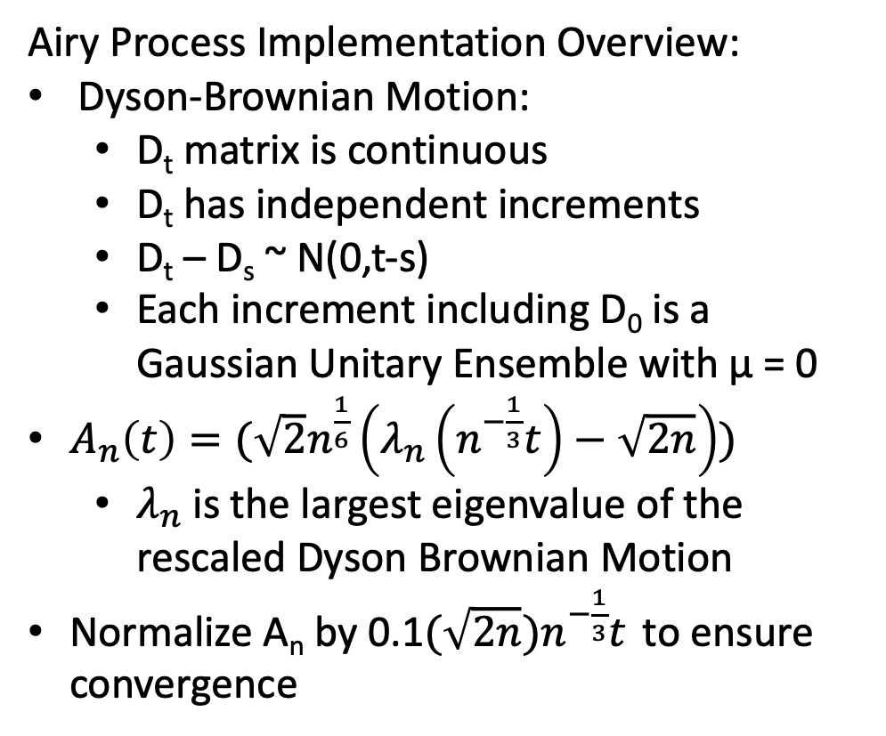
Airy Process Convergence as n goes to infinity
The Airy Process with Different n values
Airy Process Implementation Overview:
Dyson-Brownian Motion:
D_{t} matrix is continuous
D_{t} has independent increments
D_{t} – D_{s} ~ N(0,t-s)
Each increment including D₀ is a Gaussian Unitary Ensemble with µ = 0
$A_{n}\left(t\right)=(\sqrt{2}n^{\frac{1}{6}}\left(λ_{n}\left(n^{−\frac{1}{3}}t\right)−\sqrt{2n}\right))$
$λ_{n}$ is the largest eigenvalue of the rescaled Dyson Brownian Motion
Normalize A_{n} by 0.1$(\sqrt{2n}{)n}^{−\frac{1}{3}}t$ to ensure convergence

Slide 4
Theoretical Result
The theoretical result is that the probability of the Airy Process can be defined using a Fredholm determinant:
In theory each A_{ij} is an infinite size matrix, but it can be approximated using Gaussian Quadrature

Slide 5
Gaussian Quadrature Approximations
The Gaussian Quadrature is a method for approximating an integral or in this case an infinite size matrix
Every A_{ij} is an infinite size matrix that can be approximated using Gaussian Legendre Quadrature as such…
Because Gauss Legendre only works for integrals from [-1 1] it is necessary to transform K so that we can approximate the infinite size using Gauss Legendre points

Slide 6

Transformation from [-1, 1] to [s, $∞$ ]
The Paper provides instructions for transforming the integral to the interval [0, 1]
Where the As approximation is defined as follows
We also change the approximation so that we can use the Gauss Legendre approximation from [-1, 1]
$$s+10 π tan{(π(ξ+1)/4)} (ξ∈\left(−1,1\right))$$

Slide 7
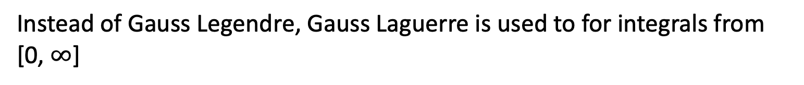
Gaussian Quadrature Approximations Part 2
Now that we have approximated the x values and weights to use on the outside, another Gaussian Quadrature is required to compute the K_{ij}
The Extended Airy Kernels are defined here
Instead of Gauss Legendre, Gauss Laguerre is used to for integrals from [0, $∞$]

Slide 8
Checking the approximation of the theoretical result
For the approximation of the Extended Airy Kernel we can compare this method against the Tracy-Widom Distribution by computing the derivative of the CDF P(A(t₁)<s)

Slide 9
Results thus far..
In this set of results I compared the empirical results with the theoretical results of P(A(20)<s) and it’s derivative

Slide 10
Results thus far..
In this set of results I compared the empirical results with the theoretical results of P(A(9)<s, A(20)<s)

Slide 11
What’s Next
I am likely missing something in my Airy Process code that needs to be debugged…

